Slide 1
Section 3.2 Product and Quotient Rules
Lecture 1
Differentiating Products

Slide 2

Homework Submission to Canvas
Preview of section
Skim the section in text and write a short paragraph summary.
Give a bulleted list of all important definitions, theorems, and formulas without details.
Notes on video lectures
Take notes on everything written on slides including all details, worked examples, on-own activities, as well as your own thoughts and questions.
Try on-own activities first, then write down provided solution next to it for comparison.
Worked examples from the text
Write down the problem and attempt without looking at the solution.
Use the solution to write the best explanation you can.
Solutions to textbook exercises
Model approaches and explanations given in the video lectures and textbook examples.
Final reflection of section
List the key takeaways to remember as a bulleted list.
Video reflection (for some sections)
Write a 1 paragraph reflection on the video discussing what you found most interesting or useful.

Slide 3
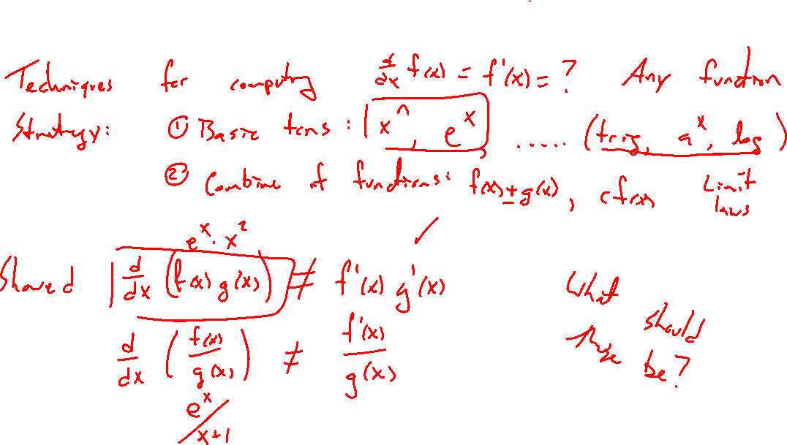
Recall: Differentiating products and quotients
Notes:
Goal, combine functions to grow complexity
D/dx (f(x) g(x) ) \neq f'(x) g'(x), so limit laws don't directly transfer.
So what is derivative of a product?

Slide 4
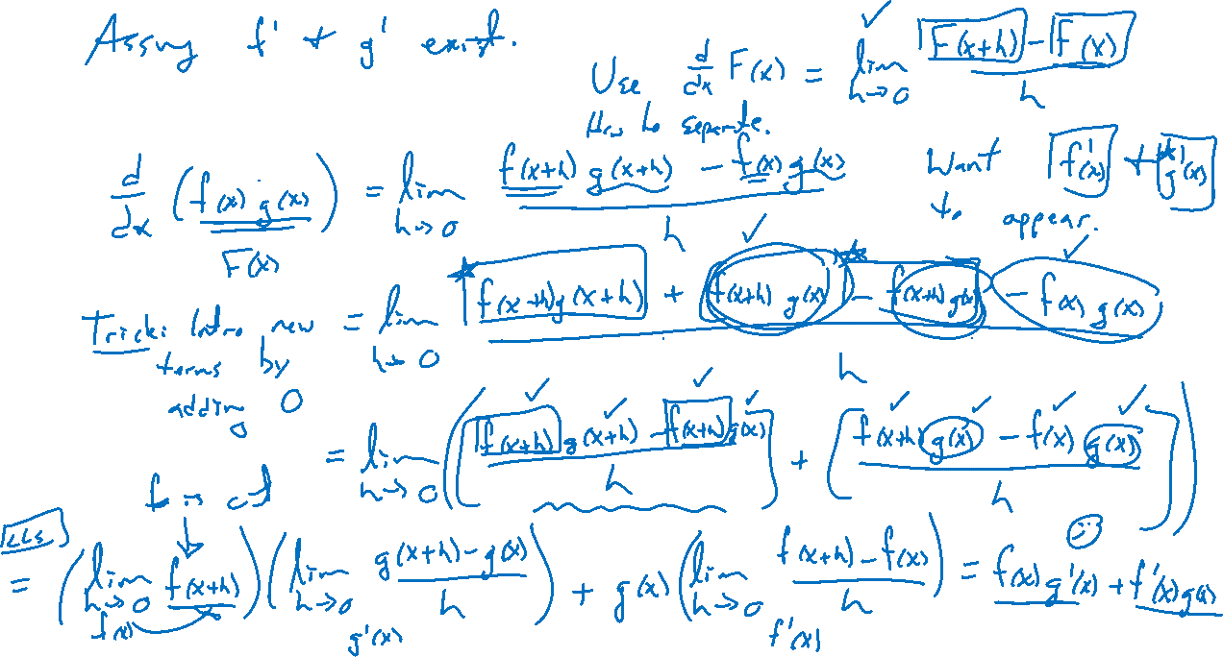
Product rule derived
Notes:
Limit of diff quotient proof. Need to separate f' and g' somehow.

Slide 5
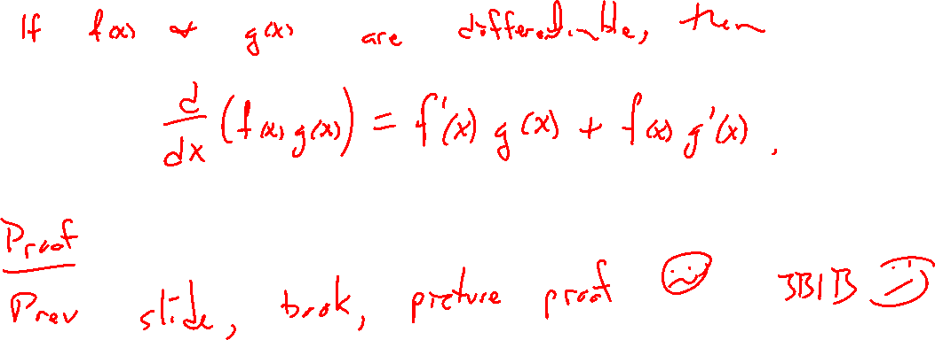
Theorem: Product rule

Slide 6
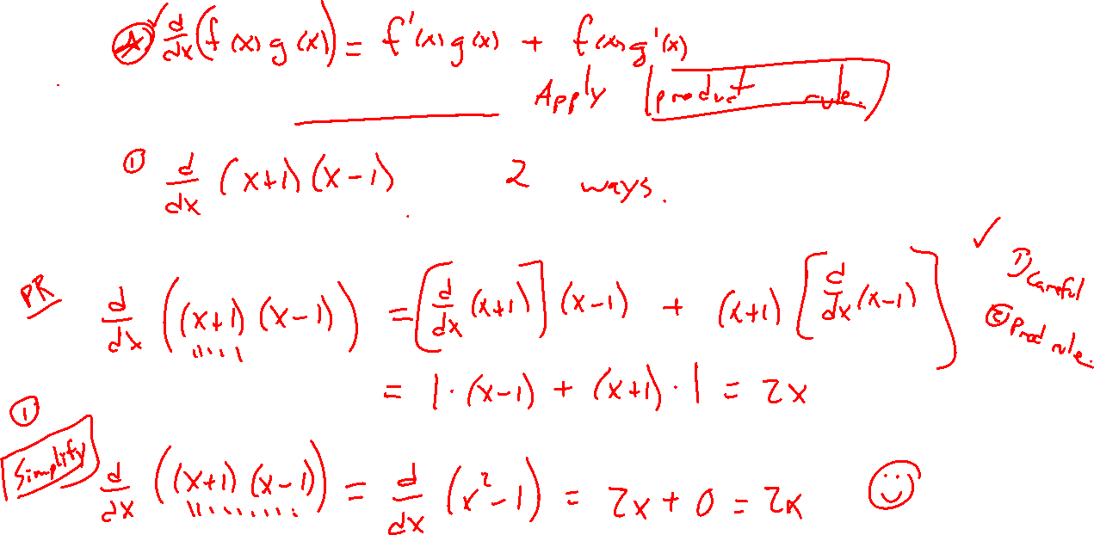
Examples: Try on own
Notes:
(x+1)(x-1) two ways
X^3 e^x + e x^e

Slide 7
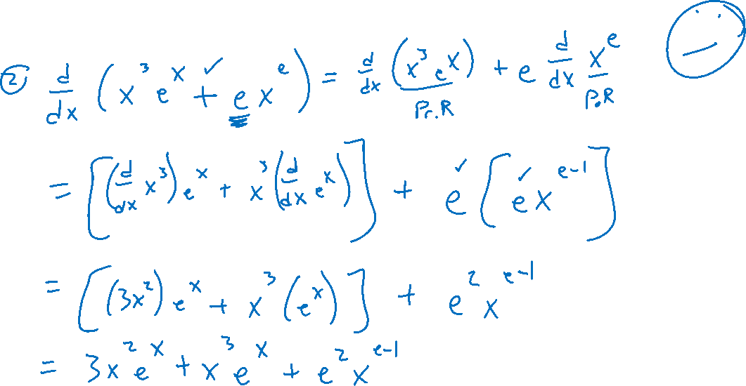
Examples: Try on own
Notes:
(x+1)(x-1) two ways
X^3 e^x + e x^e

